Slide 1

PAMI
Your AI Project Manager
Cloud Computing Workshop with AWS | Semester B Final
Osher Atias | Roy Kalfon | Or Keren
Mentor: Yogev Shani
AI-first project understanding for software teams
PAMI | AI Project Management Platform
0

Slide 2
PROBLEM + AUDIENCE
Project data is everywhere. Understanding is still manual.
Modern delivery teams use many tools, but project state remains scattered across tasks, messages, documents and informal decisions.
1
Fragmented ecosystem
2
Data Loss
3
Hollow Management tools
Jira, Slack, documents and meetings each hold part of the truth. Managers still need to connect the dots manually.
Many documents about project data is places across many systems, chatbots and books. There is no one end to end system to place them all.
Current systems only store data, not analyzing and understanding it.
Primary users
Project managers
Developers
Startup teams
Product owners
Technical leads
PAMI | AI Project Management Platform
1

Slide 3
SOLUTION
PAMI adds an intelligent project-management layer.
The platform combines a structured project model, natural-language interaction and service integrations to turn project data into guidance.
1
Capture
2
Model
3
Reason
4
Act
Projects, workers, goals, tasks, dependencies and team conversations.
Organize knowledge as structured project context, not a flat ticket list.
Use the AI service to summarize, suggest tasks and identify risk signals.
Send updates to Slack and sync execution flows with Jira.
Core idea: PAMI does not only track tasks. It keeps enough context to explain what matters and recommend concrete actions.
PAMI | AI Project Management Platform
2

Slide 4
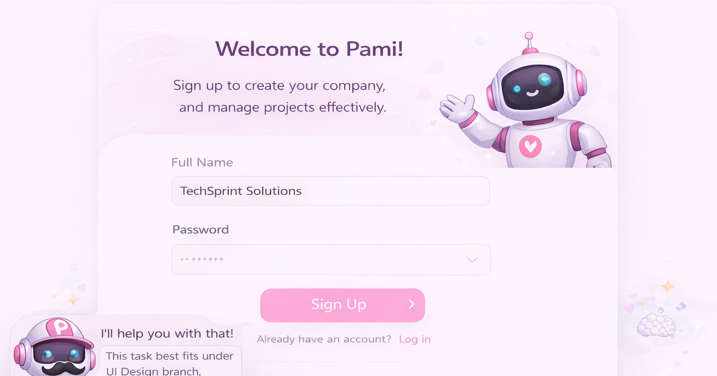
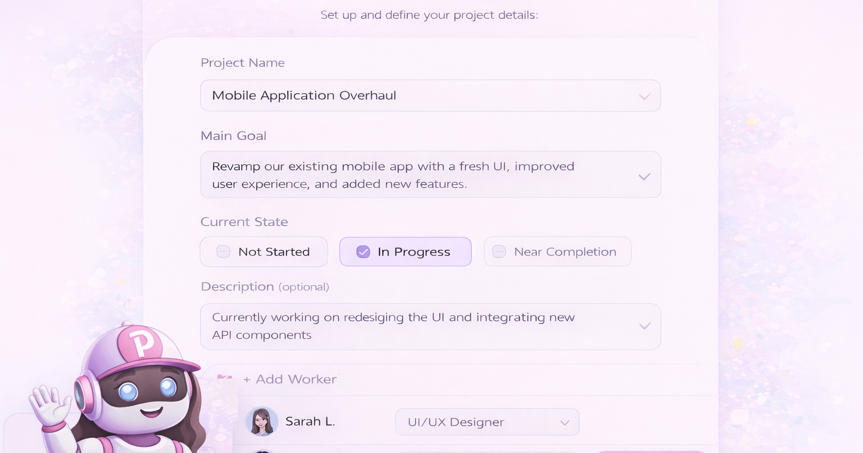
PRODUCT DEMO
Onboarding and project setup are assistant-led.
The UI uses a light PAMI visual language and guides users from company registration to defining goals, state and workers.
Registration flow
Create project flow
PAMI | AI Project Management Platform
3

Slide 5
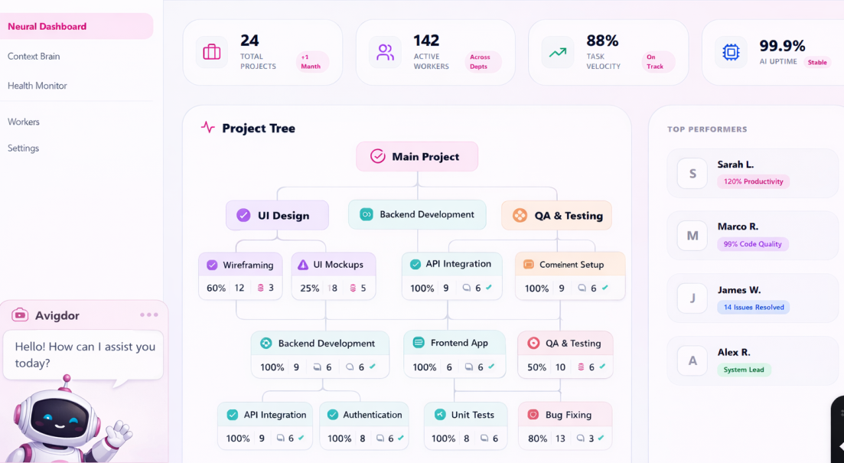
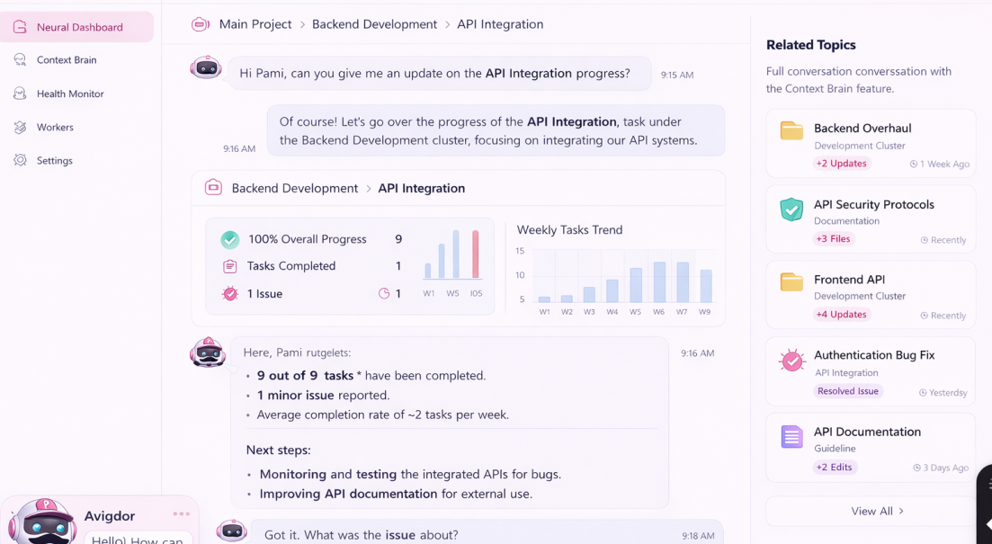
PRODUCT DEMO
Dashboard, project visibility and PAMI conversation.
The main experience combines project structure, progress indicators and a conversational copilot grounded in project context.
Project dashboard and visibility
Natural-language project assistant
PAMI | AI Project Management Platform
4

Slide 6
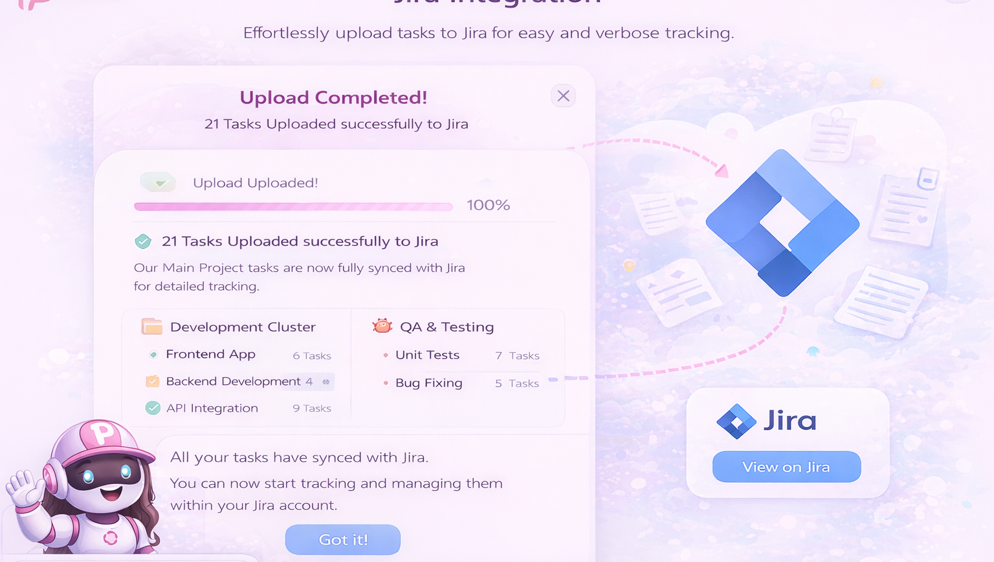
EXECUTION LAYER
PAMI connects decisions to the tools teams already use.
Integrations are used for real project execution: notifications, team updates and task tracking.
Slack service
Jira service
Connection check
List channels
Create channel
Duplicate-channel handling
Send team updates
Export tasks
Track developer workflow
Keep execution visible
Support verbose task tracking
Jira task synchronization flow
PAMI | AI Project Management Platform
6

Slide 7
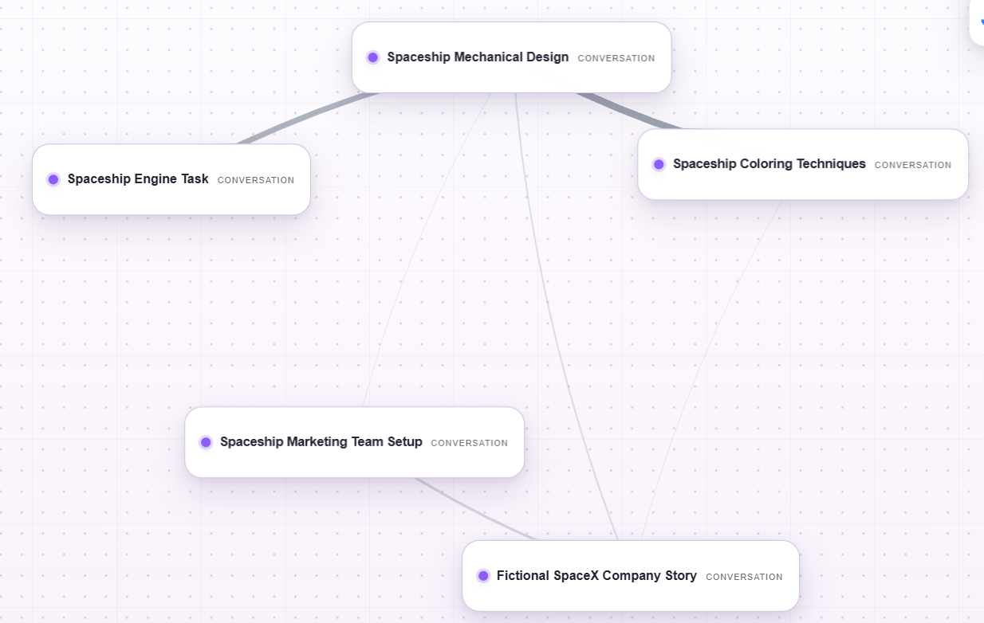
INNOVATION
The Context Brain
Context-aware project model
PAMI routes questions to the most relevant project context instead of scanning unrelated raw text.
Result: better context routing for summaries, task suggestions and decision support.
PAMI | AI Project Management Platform
5

Slide 8
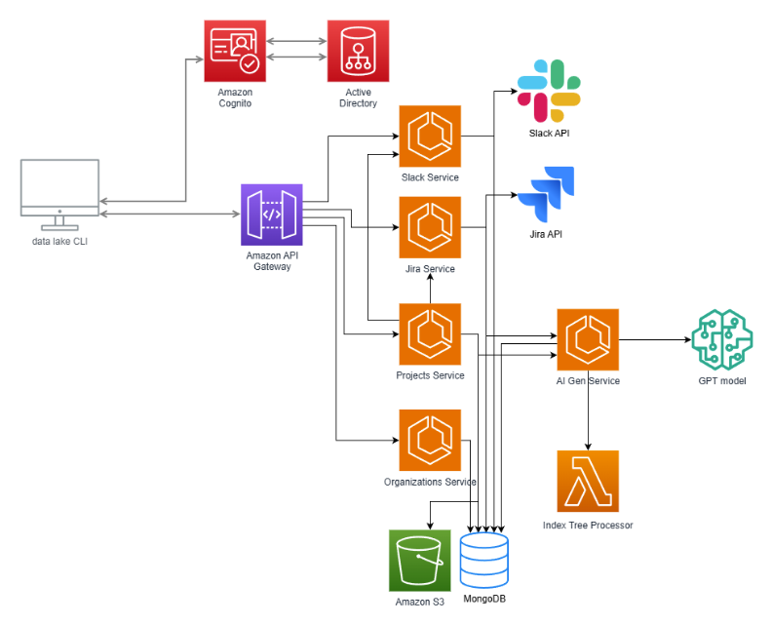



ARCHITECTURE
High-Level AWS & Microservices Architecture
The system is built as a set of microservices behind an API layer, with external Slack/Jira integrations and an AI generation path connected to GPT.
Architecture reading guide
Entry — Data Lake CLI reaches the API Gateway after authentication.
Services — Slack, Jira, Projects and Organizations are separated into dedicated services.
AI path — AI Gen Service connects project context to the GPT model and the Index Tree Processor.
Data — MongoDB stores structured app data; S3 stores heavy files and artifacts.
Execution — Slack and Jira APIs turn project decisions into team notifications and task tracking.
High-level topology: API Gateway → microservices → storage, AI and external tools
PAMI | AI Project Management Platform
7

Slide 9
ARCHITECTURE
Technology stack and deployment path.
PAMI is deployed on AWS as a microservices-based system, using GitHub Actions, Docker, ECR, and ECS/Fargate for automated deployment.
Frontend
Backend
Data
React
Axios API clients
Light PAMI UI
Python / FastAPI
Pydantic validation
Service + repository layers
MongoDB for app state
S3 for heavy files
Context data pointers
AI
Deployment
Secrets
Conversation service
Summaries and suggestions
LLM integration
GitHub Actions
Docker image to ECR
ECS/Fargate task definition
GitHub Secrets
MongoDB URL
Slack tokens and AWS credentials
Environment-based configuration keeps the services portable between local development and AWS deployment.
PAMI | AI Project Management Platform
8

Slide 10
Questions?
Thank you for your time
github.com/OrKeren8/pami
Cloud Computing Workshop with AWS
PAMI | AI Project Management Platform

